Slide 1


Tree st
Social discovery tool for organizations
PATENT PENDING – CONFIDENTIAL – DO NOT SHARE – PATENT PENDING – CONFIDENTIAL – DO NOT SHARE - PATENT PENDING – CONFIDENTIAL – DO NOT SHARE – PATENT PENDING – CONFIDENTIAL

Slide 2
Contents
Project Overview
1. Why Social Discovery?
2. Problem Summary
3. How Tree.st Works
4. Competitive Edge – Professional Networks
5. Competitive Edge – Consumer Communities
6. Validation Case Study – MIT
7. Competition & Monetization
8. Team
Appendix A-E
PATENT PENDING – CONFIDENTIAL – DO NOT SHARE – PATENT PENDING – CONFIDENTIAL – DO NOT SHARE - PATENT PENDING – CONFIDENTIAL – DO NOT SHARE – PATENT PENDING – CONFIDENTIAL

Slide 3
Tree.st / Project Overview
In the span of one year, Tree.st’s main product was developed from the ground up via 60+ face-to-face interviews
MAIN PRODUCT
Developed, http://www.tree.st
DEMO VIDEOS
http://www.tree.st/d/how
DEMO COMMUNITY
http://www.tree.st/mit
INTELLECTUAL PROPERTY
1 Provisional
VALIDATION
Tested with 700+ users
Product-market-fit shown
NEXT STEPS
Develop commercialization page
Develop marketing material
Develop sales funnel
Customer-acquisition validation
PATENT PENDING – CONFIDENTIAL – DO NOT SHARE – PATENT PENDING – CONFIDENTIAL – DO NOT SHARE - PATENT PENDING – CONFIDENTIAL – DO NOT SHARE – PATENT PENDING – CONFIDENTIAL

Slide 4
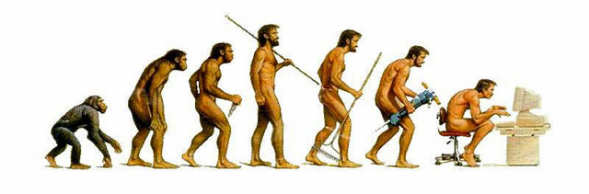
Tree.st / Why Social Discovery?
Humans are social beings. To socialize, we group ourselves based on the traits we find in the people around us
Vision allowed the caveman to see physical traits in others to build teams to achieve goals and innovate
Today we are blind, as there are few tools for individuals in organizations to find one another based on knowledge or intellectual traits
PATENT PENDING – CONFIDENTIAL – DO NOT SHARE – PATENT PENDING – CONFIDENTIAL – DO NOT SHARE - PATENT PENDING – CONFIDENTIAL – DO NOT SHARE – PATENT PENDING – CONFIDENTIAL

Slide 5



Tree.st / Problem Summary
As globalization removes national barriers, companies will compete more and more on a global level. As a consequence, the innovation these companies generate will be the greatest differentiator between winners and losers.
The greatest barrier of innovation is silo-ed thinking. Departmental silos, program silos, functional silos, and cultural silos – impede innovation at organizations from taking place. If silo-ed thinking is innovation’s greatest barrier, inter-disciplinary, inter-cultural and inter-departmental communication is its greatest driver¹.
This is an urgent and very real problem. Much research from Prof. Piskorski (HBS)², Anthony J. Bradley (VP at Gartner Research)³, among other premier research groups has been done in this space. When one analyzes why Kodak’s market share has significantly dropped, or why Apple has exploded with success, the existence or the lack of silo-ed communication is at the center of the conversation.
[1] “Medici Effect.” [2] Piskorski, Mikolaj Jan. "Social Strategies That Work." Harvard Business Review 89, no. 11 (November 2011): 116–122. [3] Bradley, Anthony J. “The Social Organization.” Harvard Review Press
PATENT PENDING – CONFIDENTIAL – DO NOT SHARE – PATENT PENDING – CONFIDENTIAL – DO NOT SHARE - PATENT PENDING – CONFIDENTIAL – DO NOT SHARE – PATENT PENDING – CONFIDENTIAL

Slide 6



Tree.st / How Tree.st Works
Tree.st creates customizable social discovery and networking tools for organizations and communities. Via a four-step process Tree.st allows people to easily find one another to innovate and/or create value
GATHER
SEARCH
GROUPS
COMMUNICATE
We ask members a series of specific questions to gather micro-level qualities – that is, qualities specific to the organization or community
Enable members to formulate rich search queries based on the same unique qualities that were gathered from a population
Members create “smart” groups – groups that automatically subscribe members that match a desired set of qualities
Members with very specific qualities and interests self-organize themselves and begin communicating
Appendix A
Appendix B
Appendix C
Appendix D
Tree.st communities have a strong sense of purpose. Via optional gamification modules and competitions we create a culture of innovation
Social Discovery
Gamification & Goals
Innovation
Tree.st creates a medium where members can find one another
Incentivizes members to create diverse teams to solve challenges
Creates results where business value can be derived
PATENT PENDING – CONFIDENTIAL – DO NOT SHARE – PATENT PENDING – CONFIDENTIAL – DO NOT SHARE - PATENT PENDING – CONFIDENTIAL – DO NOT SHARE – PATENT PENDING – CONFIDENTIAL

Slide 7


Tree.st / Competitive Edge – Professional Networks
KEY
LinkedIn and Yammer only gather broad qualities about professionals, such as their education, fields, roles, etc.
Tree.st on the other hand can gather any number of micro-level qualities specific for each profession, enabling professionals to find one another via complex searches.
If Tree.st were to create profession-specific communities:
All 3rd grade teachers could find one another and begin creating better curricula. All anesthesiologists that use XYZ drug could find one another and discuss patient side-effects. All MBA students nationwide could find each other based on interests, goals, ambitions.
If organizations and businesses were to have their own private Tree.st communities, employees would be able to easily find one another and jump across departmental or functional silos.
Broad qualities
Micro qualities
Broad Qualities
Role
Career
Education
Location
Micro Qualities
Professions
Lawyers
Doctors
Pilots
Pepsi
Personality
Patients
Airplanes
Brand Focus
Judges
Specialties
License Type
Geography
Cases
Approach
Experience
Department
Wins
Work Style
Airports
Years at …
Creativity
Tree.st
Analytical
PATENT PENDING – CONFIDENTIAL – DO NOT SHARE – PATENT PENDING – CONFIDENTIAL – DO NOT SHARE - PATENT PENDING – CONFIDENTIAL – DO NOT SHARE – PATENT PENDING – CONFIDENTIAL

Slide 8



Tree.st / Competitive Edge – Consumer Communities
Facebook has limited search functionality and depth. As a consequence, Ark has been well received by audiences and investors.
Yet Ark will always be restricted to the broad qualities it can gather from the Facebook and LinkedIn API. Unlike Facebook or Ark, Tree.st can host countless public communities that provide its members a feature-rich search engine that uses both broad and micro-level qualities. Such functionality could enable:
All the Latin parents that like sailing to find one another. All the youngsters that play Xbox’s Halo around a block to know one another. All the single gluten-free folks that play an instrument to hold concerts.
Because of Tree.st’s gamification functionality our public facing communities will not use an advertisement model, but will rather use a point-based monetization strategy (See Appendix B) where members pay by usage.
KEY
Broad qualities
Micro qualities
Location
Education
Workplace
Limitless Search Options
Personality
Patients
Airplanes
Explorer
Sports
Specialties
Married
Deaf
Books
Parent
Height
Traveled to
Single
Work Style
Hobbies
Languages
Artistic
Tree.st
Skills
Gamer
Religion
PATENT PENDING – CONFIDENTIAL – DO NOT SHARE – PATENT PENDING – CONFIDENTIAL – DO NOT SHARE - PATENT PENDING – CONFIDENTIAL – DO NOT SHARE – PATENT PENDING – CONFIDENTIAL

Slide 9
Tree.st / Validation Case Study – MIT
We validated Tree.st at MIT with 700+ students by creating three nested communities
MIT
Currently 10% of MIT graduates use Tree.st to find each one another based on a number of unique qualities never before gathered – including “shoe size”
Potential inter-departmental collaborations led to a meeting with Dean of Graduate Students and the Dean of Student Life to potentially institutionalize the MIT Tree.st community in the coming years
10% of MIT graduates
Inter-departmental comm.
Improved student life
MIT SLOAN
In the first two weeks on Fall 2012 40% of all current MIT Sloan students joined the MIT Sloan Tree.st community. Each was characterize with 45 unique qualities. The MIT Sloan Tree.st community became the one and only place where MIT Sloan students could easily discover others. For example: all the female, gluten-free, ex-consultants living in Central Square connected with one another. Tool created enough attention to create a news article in school newsletter
40% of school in 2 weeks
45 unique qualities
20+ “Smart Groups”
ENTREPRENEURSHIP & INNOVATION TRACK
Prof. Edward Roberts saw value in the Tree.st to create diverse entrepreneurial teams for the Entrepreneurship Track. MIT Sloan Entrepreneurs grouped themselves before school started by industry, geographical region, and goals of interest. This allowed the innovators to begin communicating with one another before classes began
Soon we were contacted by Peter Thiel’s (founder PayPal) Foundation to setup a similar community for their mentor mentee network
58 unique qualities
Grouped by industry
Contacted by Peter Thiel’s Foundation
PATENT PENDING – CONFIDENTIAL – DO NOT SHARE – PATENT PENDING – CONFIDENTIAL – DO NOT SHARE - PATENT PENDING – CONFIDENTIAL – DO NOT SHARE – PATENT PENDING – CONFIDENTIAL

Slide 10
Tree.st / Competition & Monetization
Competition
For professional discoverability only
Negligible for other industries
Monetization, LV, and Scale
Appendix A
DIRECT
MONETIZATION
N/A
Initially pure-play B2B SaaS model, later will add on-premise solution for enterprises, followed by public facing Tree.st communities for niche-populations using an advertisement model
POTENTIALLY DIRECT
Ark.com
Consumer social discoverability tool, combines Facebook and LinkedIn data in a search engine
Series A $4M (2011)
LIFETIME VALUE
We expect customer lifetime value to be high since Tree.st collects micro-level qualities not available anywhere else. Though customer has data ownership, the Tree.st data structure and intellectual property makes it impractical for customer use
Yammer.com
Requires infrastructure changes to gather micro-level qualities for each client and a search tool to create discoverability feature
SCALE
INDIRECT
Given the decentralized nature of the engineering behind Tree.st – scalability is not a problem. Most initial capital will be used for sales and marketing after customer acquisition validation is complete
LinkedIn.com
Contains a professional social discoverability feature, monetization requires search engine to have limited usage to most users
Among others…
PATENT PENDING – CONFIDENTIAL – DO NOT SHARE – PATENT PENDING – CONFIDENTIAL – DO NOT SHARE - PATENT PENDING – CONFIDENTIAL – DO NOT SHARE – PATENT PENDING – CONFIDENTIAL

Slide 11





Tree.st / Team
UC Berkeley Bioengineer/CS; Co-founded startups in high school with profits of $200K per year; First employee of startup with $4M Series A, startup raised $22.5M in Series B. Lead software engineer for large-data genomic projects with the DOE at LLNL. MIT Sloan MBA 2013.
Northwestern University/Industrial Engineering; 4yrs corporate banking at HSBC Bank in the chemicals sector. Co-founder of an investment partnership with former Northwestern professor. MIT Sloan MBA 2014
Omid Sadeghpour
Shailesh Mittal
Technology
Sales
University of Colorado/Aerospace, led a nine member engineering test team, managed quality assurance for Azerbaijan's first satellite, ran three satellite launch campaigns" sales/operations. MIT Sloan LGO MBA 2013
MIT Sloan Fellow '13, Lawyer, LL.M. Established and led the legal department of an international media representative; managed business and contractual negotiations with high-tech startups; developed e-business initiatives.
Alexander Romanov
Jan Widmer
H@ck3r
Strategy
PATENT PENDING – CONFIDENTIAL – DO NOT SHARE – PATENT PENDING – CONFIDENTIAL – DO NOT SHARE - PATENT PENDING – CONFIDENTIAL – DO NOT SHARE – PATENT PENDING – CONFIDENTIAL

Slide 12

Thank you
PATENT PENDING – CONFIDENTIAL – DO NOT SHARE – PATENT PENDING – CONFIDENTIAL – DO NOT SHARE - PATENT PENDING – CONFIDENTIAL – DO NOT SHARE – PATENT PENDING – CONFIDENTIAL

Slide 13
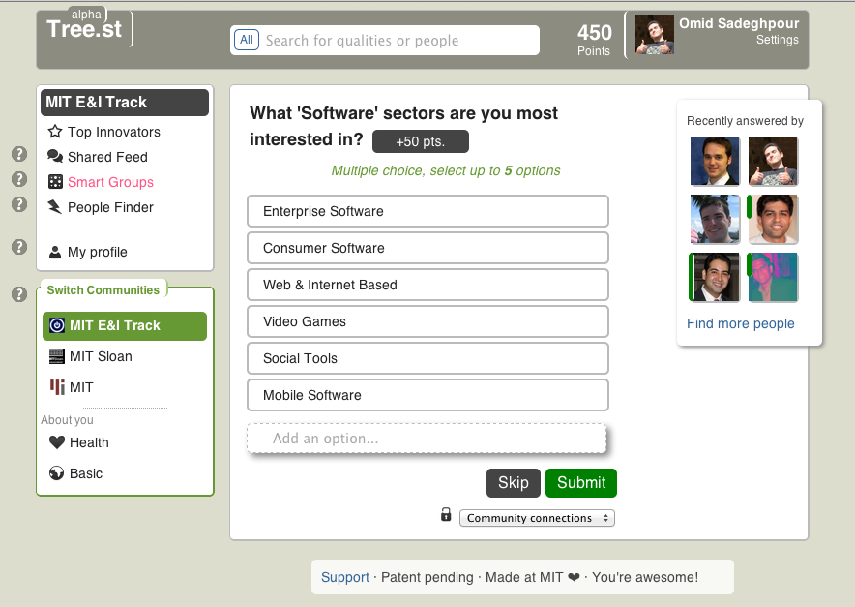
Tree.st / Appendix A – Data Gathering
Data Gathering – when members join they are asked community specific questions driven by an underlying decision tree. Members can be incentivized to answer questions by gaining points. Because Tree.st gathers very specific member details we expect the lifetime value of our customers to be higher than normal
PATENT PENDING – CONFIDENTIAL – DO NOT SHARE – PATENT PENDING – CONFIDENTIAL – DO NOT SHARE - PATENT PENDING – CONFIDENTIAL – DO NOT SHARE – PATENT PENDING – CONFIDENTIAL

Slide 14
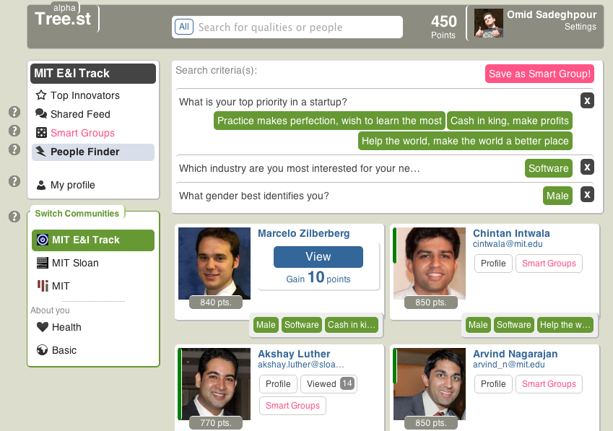
Tree.st / Appendix B – People Finder
Search
Demonstrates a search for a “male” entrepreneur interested in the “software” industry who wants to either “help the world,” “make cash,” or “just learn” about startups by practicing.
Gamification
In this community users “gain 10 points” for viewing one another, in another community users might have to “pay 10 points” to view one another. Users can also set custom points based on their schedule and availability to encourage or discourage others from contacting them.
PATENT PENDING – CONFIDENTIAL – DO NOT SHARE – PATENT PENDING – CONFIDENTIAL – DO NOT SHARE - PATENT PENDING – CONFIDENTIAL – DO NOT SHARE – PATENT PENDING – CONFIDENTIAL

Slide 15
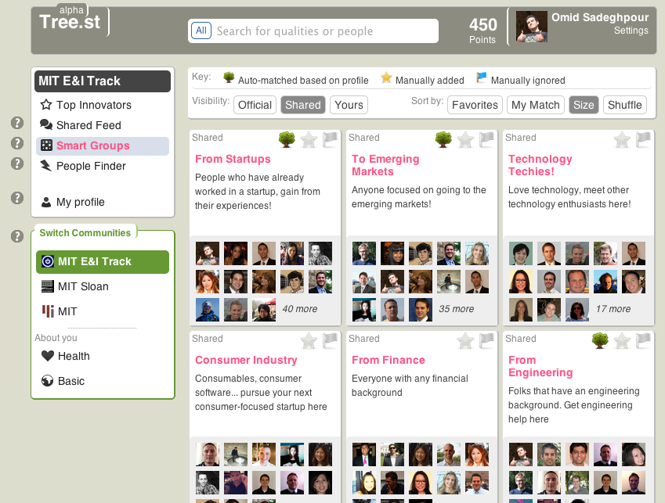
Tree.st / Appendix C – Smart Groups
Smart Groups – community members can create “smart” groups that add new and old members to the group based on how well a user matches the “smart” group’s search criteria. These “smart” groups are great for dynamic and transitory populations
PATENT PENDING – CONFIDENTIAL – DO NOT SHARE – PATENT PENDING – CONFIDENTIAL – DO NOT SHARE - PATENT PENDING – CONFIDENTIAL – DO NOT SHARE – PATENT PENDING – CONFIDENTIAL

Slide 16
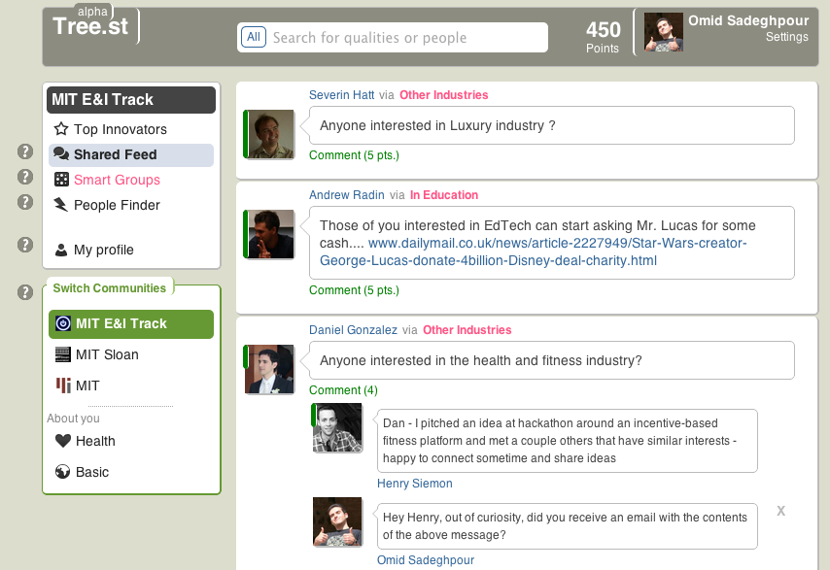
Tree.st / Appendix D – Shared Feed
Communication – members post messages at the “smart” group level, this keeps conversations relevant and to the point. “Smart” group messages can then be viewed at the community level where all “smart” group messages are combined into a single view uniquely made based on the member’s interest
PATENT PENDING – CONFIDENTIAL – DO NOT SHARE – PATENT PENDING – CONFIDENTIAL – DO NOT SHARE - PATENT PENDING – CONFIDENTIAL – DO NOT SHARE – PATENT PENDING – CONFIDENTIAL

Slide 17
Tree.st / Appendix E - Financials
With two product tiers (SaaS & Enterprise in-location) we will breakeven in 14 quarters (3.5 years). We expect to spend capital early on in marketing and sales. Given our projections, Tree.st will have early stage financials similar to LinkedIn and Microsoft
PATENT PENDING – CONFIDENTIAL – DO NOT SHARE – PATENT PENDING – CONFIDENTIAL – DO NOT SHARE - PATENT PENDING – CONFIDENTIAL – DO NOT SHARE – PATENT PENDING – CONFIDENTIAL

